Slide 1

Annual Program Review Update
April 3, 2024
Sujoy Das, Vice Provost, Institutional Research, Assessment & Accreditation
Joseph Hawk, Executive Director, Assessment & Accreditation
Anna Chrulkiewicz, Senior Vice Provost, Finance & Administration

Slide 2
Why Program Review?
The idea of standardized programs metrics surfaced in the Academic Resource Planning sub-committee of Pre-Planning work that set the foundation for the current.
The process should provide more efficient management of the portfolio allowing for each program to be managed effectively saving time and effort

Slide 3
Annual Program Performance Review
Goals of Annual Program Performance Review Process
Strengthen culture of continuous improvement​
Strengthen culture of accountability for program performance​
Provide timely data for decision making
Committee Charge:
The Program Performance Review Committee will:
Evaluate and formalize dashboards​
Outline expectations and process for program review

Slide 4

Tactical Dashboard
Description:
A set of 16 metrics reviewed and agreed upon by a representative committee composed of faculty and staff
Process:
The dashboard will be available for all to see throughout the year but will be part of the annual review process.
Programs will review and comment on trends found in each metric.
Benefit:
More effective usage of time for strategic planning

Slide 5
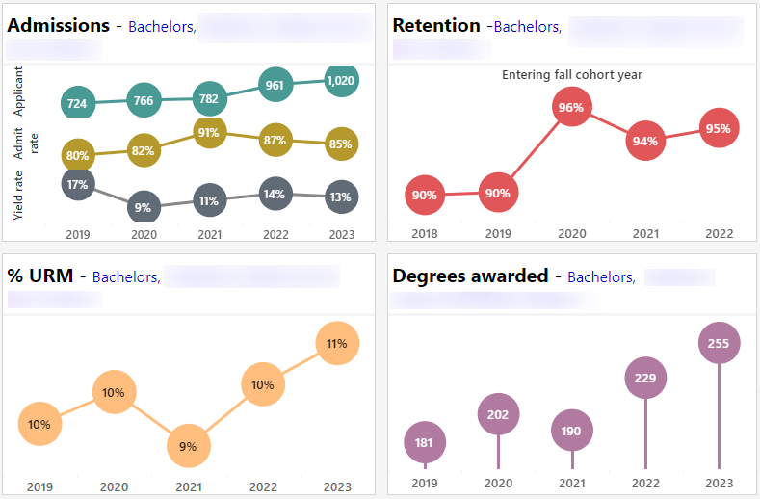
Tactical Dashboard Metrics - Part 1

Slide 6
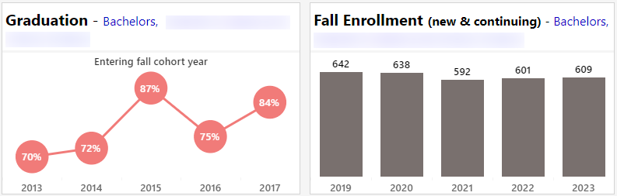
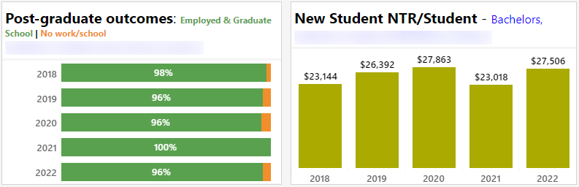
Tactical Dashboard Metrics - Part 2

Slide 7
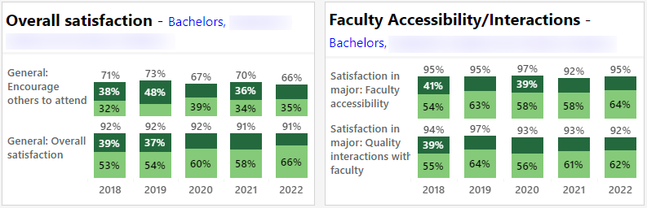
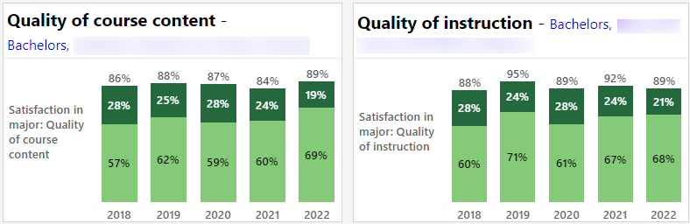
Tactical Dashboard Metrics - Part 3

Slide 8
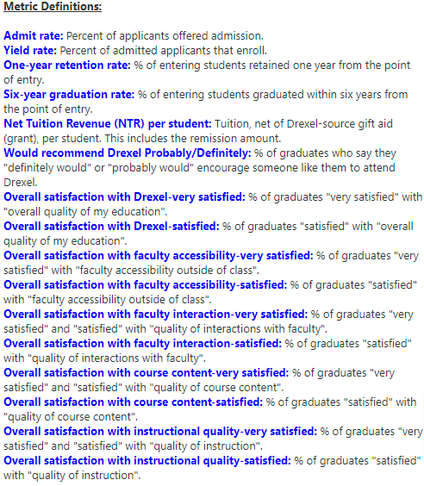
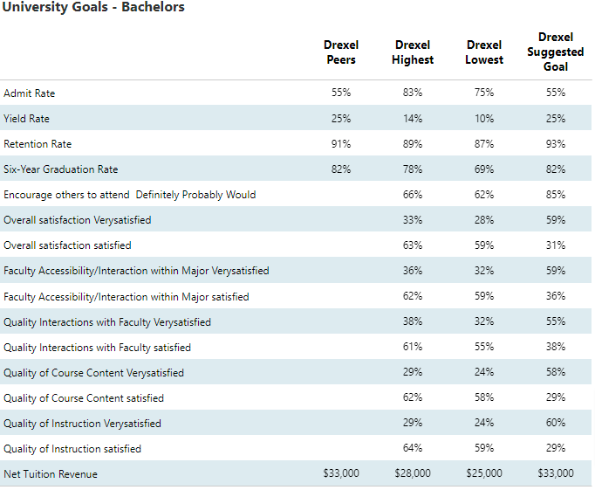
Tactical Dashboard Detailed Definitions/Benchmarking
Notes:
The 5 metrics with external benchmark goals: Admit Rate, Yield Rate, Retention Rate, 6-Year Graduation Rate and Net Tuition Revenue. All other metrics have internal benchmark goals.

Slide 9
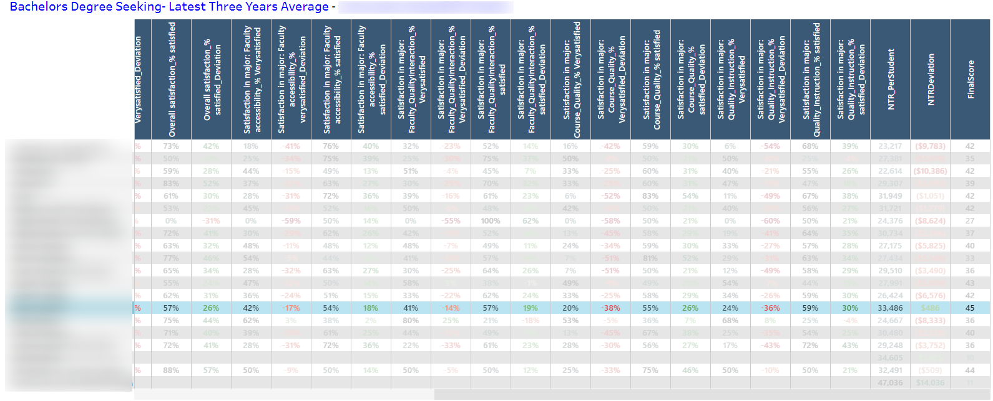
Tactical Dashboard College View

Slide 10
Strategic Dashboard
Description:
A compliment to the Tactical Dashboard, this will be used to determine if there is alignment to the strategic plan and to what extent.
Process:
Faculty or professional staff will rate themselves and provide evidence for that rating
This rubric can be used by program directors, faculty, and individual school/college administration to discuss and develop solutions and strategic planning for programs
No program will be fully aligned in all categories and some categories may not apply to all programs

Slide 11
Strategic Dashboard Example
Category | Criteria | Strong Alignment | Partial Alignment | No Alignment
Research & Creative Scholarship | Supports Students and Faculty Engaged in Research, Scholarly, Creative Student placement in PhD programs Student publications, patents, grants Faculty publications, patents, grants
 | Regional, National, or Industry Impact of Program Research Are there patents or press about the program, faculty associated with the program, or students in the program?

Slide 12
Overview of the process
Program Report
  Tactical dashboard is ready for review
  Provide strategic context and any necessary actions
College Report
  Aggregation and synthesis of program-level reports
  Identifying college-level themes
University Report
  Aggregation and synthesis of college-level reports
  Identifying university-level themes

Slide 13
PROPOSED Timeline
Apr–June
Programs develop Program Report
June–July
Deans create College Report
Aug–Sep
Deans meet with Provost team and then create action plans
Sep–Nov
University Report created

Slide 14
Tableau Dashboard
Program Performance Trend - Bachelors
Notes
Program Benchmarking Report – Bachelors
Program Report – Masters
Program Performance Trend - Masters
Annual Program Review Dashboard

Slide 15
Appendix

Slide 16
Annual Report Process
Program Report: Programs will review and provide information about the status on the Tactical Dashboard and then complete the Strategic Dashboard to share it with the college/school
College/School Report: Deans and staff will create a college-level report that will aggregate the program-level data to share with the Provost (and team) and the PPRC Oversite Committee.
  Deans and their teams will meet with the Provost team to discuss College Report
  The Deans will create an action plan based on their report and the meeting
University Report: The Provost and Team develop a report based on the College reports in concert with the PPRC Oversite Committee

Slide 17
Program Report Strategic Dashboard
Part 1:Complete the slide bars to identify the programmatic role within the university
Direct Education of Students
Scholarly, Research and Creative Activities
Service Activities
Part 2: Complete the alignment rubric
This is not a scored rubric seeking X number of points. It is a visual rubric to assess alignment because no program will be in “strong alignment” across all criteria.
Categories: Curriculum, Research, Experience, Community
Provide evidence of rating
Explain why any section was unrated
There may have several criteria where there is no alignment

Slide 18
Program Report Tactical Dashboard
Programs will see the following for each metric (UG so far)
The Tactical Goal based on strategic peer benchmarks
Drexel University’s Lowest Score
Drexel University’s Highest Score
Program 3-year trend
Please provide an update on any action plans/areas of concern from last year (if applicable)
These plans could be for more than one year
Please provide a context for 3-year trends that are either positive or negative (all of them?)
Please create an action plan for the next year (provide an executive summary)
This action plan could have initiatives that last for more than one year.
If a metric has been trending down, how you will address this area of concern?
If a metric is stagnant, are there things that can be done to improve?
If a metric is doing well, how can you share this information with other programs?
Please provide goals and key performance indicators for the next year (and beyond)

Slide 19
College Report PART 1
Please provide an update on any action plans/areas of concern from last year (if applicable)
Please provide a summary of strengths and weaknesses for the college
Please provide comments/context for programs that are areas of concern
Please provide suggested efficiencies
Please provide examples of effective practices and programs/initiatives that you would like to highlight
Extra:
Please describe major initiative for next year and beyond
Some goals will take longer than one year to achieve
Please provide the goals for next year and beyond
Some goals will take longer than one year to achieve
Part 1: Tactical Dashboard

Slide 20
College Report Parts 2 & 3
Part 2: Strategic Dashboard:
Please provide college level initiatives in support of the strategic plan
Please provide narrative around strengths and weaknesses with the college’s contributions to the strategic plan
Please describe future initiatives that will support advancement within the strategic plan.
Please provide aggregate data on the college's contributions to each area
Step 3: Process Improvements
Do you have any suggestions for the process?

